Slide 1

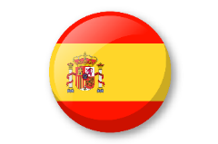
Medium Term Plan:
Stage 1 The calendar and celebrations
In this module:
During this half term the children will revisit colours with a fireworks theme. They will go on to learn the days of the week and months of the year.
Through songs, games, native speaker clips and independent tasks, they will explore the following content, topics and language:
Fireworks colours
Revisit and recall colours
Learn new colours
Calendar Time
Learn the names of days of the week
Follow a story about days of the week
Learn the months of the year
Recognise the nouns written down
Express their birthday month
Date
- Write the date in Spanish.
Celebrations
- Learn about Christmas traditions in Spain.
Learning Objective for each lesson:
I can say and write some colours linked to fireworks.
I can say and write some days of the week.
I can remember days of the week in Spanish.
I can understand some months of the year in Spanish.
I can read and write dates in Spanish.
I can remember months and learn about how Christmas is celebrated in Spain.
Examples of work – Calendar and celebrations
Key Performance Indicators
Can read and say adjectives of colour. Can recognise and say days of the week. Can attempt to copy-write accurately a day of the week. Can recognise and say most months of the year. Can attempt to write accurately an important month of the year.
© Primary Languages Network 2020

