Slide 1
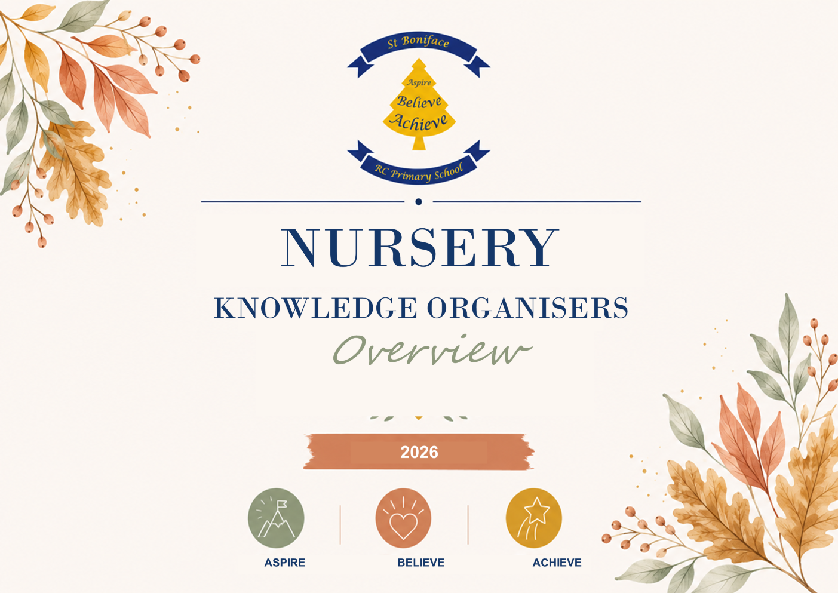

Slide 2










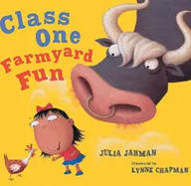




St. Boniface RC Primary
Nursery
History Yearly Knowledge Overview
Key Learning :
Autumn 1 – All About Me To talk about how I was a baby in the past. | Spring 1 – What is it like in Space? Recall a journey I have been on. | Summer 1 – People who help us.
Autumn 2 – What do we Celebrate? Continue developing positive attitudes about the differences between people | Spring 2 – How do we grow? To know plant grows from a seed. | Summer 2 – Under the Sea Talk about special days I have celebrated.
Key Books :
Autumn 1 – All About Me | Spring 1 – What is it like in Space? | Summer 1 – People who help us.
Autumn 2 – What do we Celebrate? | Spring 2 – How do we grow? | Summer 2 – Under the Sea
Key Vocabulary
Now, next, family, family members names, mum, dad, brother, sister, dog, cat, rabbit, pets, Past, before, events, then new, old, present, different, same, rusty, black and white, modern, happens, experiences, Easter, egg hunt, Family, live with, questions, happened, Sequence, first, last, and then, before, family, names, family tree.
Knowledge Nuggets
I was a baby in the past
Talk about a journey I have been on with my family.
Special days I have had in the past
In the past a plant was a seed.
Use correct language of time.
Understanding the World
Begin to make sense of their own life-story and family’s history.

Slide 3
St. Boniface RC Primary
Nursery
Geography Yearly Knowledge Overview
Key Learning :
Autumn 1 – All About Me To know our school is in Lower Broughton Look at the map of our local area. Draw picture of our family home | Spring 1 – What is it like in Space? A route shows someone the way to go. Draw a map of the playground. | Summer 1 – People who help us. To recognise people have different jobs in our school,/area i.e. bus driver/ cook.
Autumn 2 – What do we Celebrate? Circle time discussing how living in Lower Broughton can be different to living in another country. | Spring 2 – How do we grow? Past and present Look at a variety of picture to discuss how our local area has changed over the years. | Summer 2 – Under the Sea Circle time discussing how living in Lower Broughton can be different to living in another country.
Key Books :
Autumn 1 – All About Me | Spring 1 – What is it like in Space? | Summer 1 – People who help us.
Autumn 2 – What do we Celebrate? | Spring 2 – How do we grow? | Summer 2 – Under the Sea
Knowledge Nuggets
To say where they live
To know a map shows someone the way to go.
To be able to name people who help us in our school, family or local area.
To answer how living in Lower Broughton can be different to living in another country.
Key Vocabulary
Nursey , Lower Broughton, school, Family, family names, special. Friends, care, look after, home, bedroom, kitchen, living room, bathroom, Christmas. Shop, memorial, stop sign, traffic light, transport, community, local areas, same, different, celebrate, Chinese New Year. Differences, same, similar, jobs, firefighter, police officer, shop worker, postal worker, driver, doctor, nurse Belonging, groups, own ideas, the world, other countries, other people. Getting along, patience, tolerance. Names of the features in the environment, countries, hot, cold.
Understanding the World
To understand the importance of looking after our environment.
Show interest in different occupations
To know there are different countries in the world.
Use construction blocks to create small worlds, parks and farms.

Slide 4
St. Boniface RC Primary
Nursery
Science Yearly Knowledge Overview
Key Learning :
Autumn 1 – All About Me Our Bodies Discuss how our bodies have changed and what happens to them when we exercise. | Spring 1 – What is it like in Space? Freezing and Melting Children to put small figures into water and in the freezer, what will happen? Children to make chocolate crispy cakes what will happen to the chocolate? | Summer 1 – People who help us. Light & Dark Glow stick experiment using 2 jars of water and glow sticks children to predict what will happen when the sticks are added to water.
Autumn 2 – What do we Celebrate? Observe changes to the environment walk around school grounds and ask children to observe what they see. | Spring 2 – How do we grow? Planting a seed Children to plant their own seeds and observe changes. Experiment by putting a seed in a dark cupboard and one in the light. Children to make predications. | Summer 2 – Under the Sea Floating & Sinking Children to collect a variety of objects from the classroom and predict whether they will float or sink
Key Books :
Autumn 1 – All About Me | Spring 1 – What is it like in Space? | Summer 1 – People who help us.
Autumn 2 – What do we Celebrate? | Spring 2 – How do we grow? | Summer 2 – Under the Sea
Knowledge Nuggets
I can begin to know how babies grow and change
Investigate with ice
I can plant a seed and look after it.
Talk about changes to a growing seed.
Begin to understand how to care for the environment.
Key Vocabulary
Respect care, look after, home, school, nursery, touch, see, feel, smell, hear, taste. Weather, sunny, raining, snowing, ice, autumn, winter, summer, spring, body part names, explore. care, look after, natural, Seeds, soil, water, care, look after, grow, changes, why
Understanding the World
Plant seeds and care for growing plants. Understand the key features of the life cycle of a plant and an animal. Begin to understand the need to respect and care for the natural environment and all living things

Slide 5
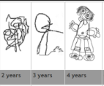
St. Boniface RC Primary
Nursery
Art Yearly Knowledge Overview
Key Learning :
Autumn 1 – All About Me To know that simple objects can represent objects. | Spring 1 – What is it like in Space? Create a moon surface picture Apply different amounts of pressure to the pencil to create light and dark contrast. | Summer 1 – People who help us. Matching the correct colours of emergency workers uniforms to pictures. Explore, experiment and respond to colour through collecting sorting and matching
Autumn 2 – What do we Celebrate? Create a Firework Picture Hold a paint brush correctly and chooses colours to create pictures | Spring 2 – How do we grow? Hand print flowers and fruit and veg printing. Can children use primary colours correctly by name and match them correctly to the vegetables to print. | Summer 2 – Under the Sea Shell painting. Children to independently clean the brush when adding details to the shell to avoid colours combining.
Key Books :
Autumn 1 – All About Me | Spring 1 – What is it like in Space? | Summer 1 – People who help us.
Autumn 2 – What do we Celebrate? | Spring 2 – How do we grow? | Summer 2 – Under the Sea
Knowledge Nuggets
How to hold a paint brush correctly
To know a brush must be cleaned before using another colour.
New colours can be made through mixing other colours together
Name primary colours – red, blue, yellow
To know that simple objects can represent objects.
Learn how to apply different amounts of pressure to the pencil.
Explore, experiment and respond to colour through collecting sorting and matching
Key Vocabulary
pencil | Dip | Primary colour names | Paper
draw | paint | Stick | Colour
Brush | picture | Glue | Join
Lowenfield Stages of Development in Drawing.

Slide 6
St. Boniface RC Primary
Nursery
Design Technology Yearly Knowledge Overview
Key Learning :
Autumn 1 – All About Me Construction To build on large scale Build a house from large construction blocks | Spring 1 – What is it like in Space? Joining – develop skills to use varied range of joining techniques e.g. gluing, weaving, hole punching to create a space rocket from recycled materials. | Summer 1 – People who help us. Joining Children develop tearing and folding skills when completing a cut and Stick doctors bag activity.
Autumn 2 – What do we Celebrate? Cooking – Experiments with ingredients, measuring and creating a cake. Construction To build on large scale Den building on large scale outside using a variety of resources. | Spring 2 – How do we grow? Salad Making Cooking-using equipment required to chop foods Experiment with tools needed for cutting vegetables for a salad. | Summer 2 – Under the Sea Create a rainbow fish. Children to select from a variety of materials, children independently select the tools and materials to do this independently.
Key Books :
Autumn 1 – All About Me | Spring 1 – What is it like in Space? | Summer 1 – People who help us.
Autumn 2 – What do we Celebrate? | Spring 2 – How do we grow? | Summer 2 – Under the Sea
Knowledge Nuggets
Explore different materials freely, to develop their ideas about how to use them and what to make
Develop their own ideas and then decide which materials to use to express them.
Join different materials and explore different textures.
Use blocks to build a house.
Use materials to make a space rocket.
Manage tools carefully to cut, chop and snip.
Make imaginative ‘small worlds’ with blocks and construction kits.
Key Vocabulary
Construction, build, ideas, paint, print, why, what, colour, mixing, new, create, friend, together.

Slide 7
St. Boniface RC Primary
Nursery
Maths Yearly Knowledge Overview
Key Learning :
Number Comparrison Compare quantities using language: ‘more than’, ‘fewer than’. Counting Recite numbers past 5. Say one number for each item in order: 1,2,3,4,5. Show ‘finger numbers’ up to 5. Link numerals and amounts: for example, showing the right number of objects to match the numeral, up to 5. Cardinality Develop fast recognition of up to 3 objects, without having to count them individually (‘subitising’). Know that the last number reached when counting a small set of objects tells you how many there are in total (‘cardinal principle’). Experiment with their own symbols and marks as well as numerals. Solve real world mathematical problems with numbers up to 5. | Shape, Space & Measure Spacial Awareness Understand position through words alone – for example, “The bag is under the table,” – with no pointing. Describe a familiar route. Discuss routes and locations, using words like ‘in front of’ and ‘behind’. Shape Talk about and explore 2D and 3D shapes (for example, circles, rectangles, triangles and cuboids) using informal and mathematical language: ‘sides’, ‘corners’, ‘straight’, ‘flat’, ‘round’. Select shapes appropriately: flat surfaces for building, a triangular prism for a roof etc. Combine shapes to make new ones – an arch, a bigger triangle, etc. Pattern Talk about and identify the patterns around them. For example: stripes on clothes, designs on rugs and wallpaper. Use informal language like ‘pointy’, ‘spotty’, ‘blobs’, etc. Extend and create ABAB patterns – stick, leaf, stick, leaf. Notice and correct an error in a repeating pattern. Begin to describe a sequence of events, real or fictional, using words such as ‘first’, ‘then…’ Measure Make comparisons between objects relating to size, length, weight and capacity.
Learning overview :

Slide 8
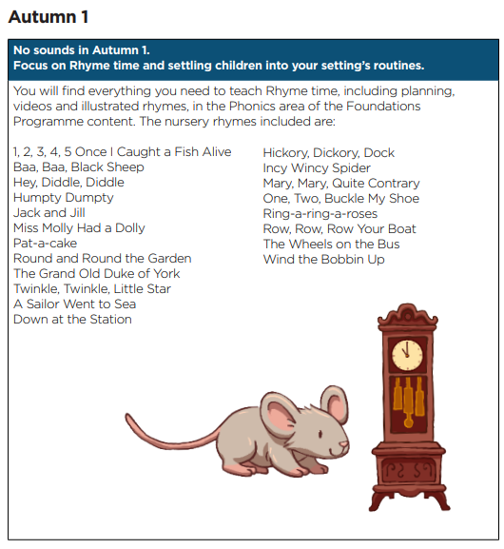
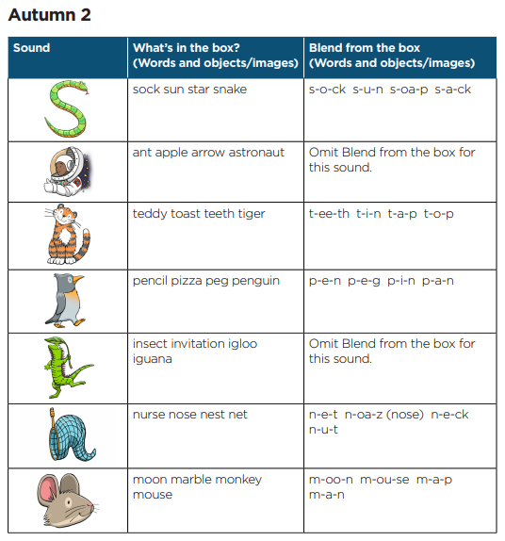
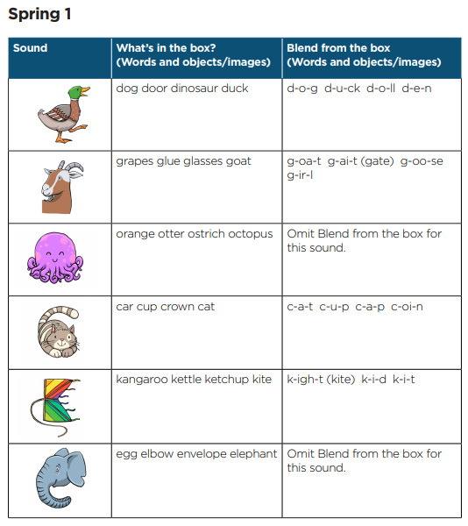
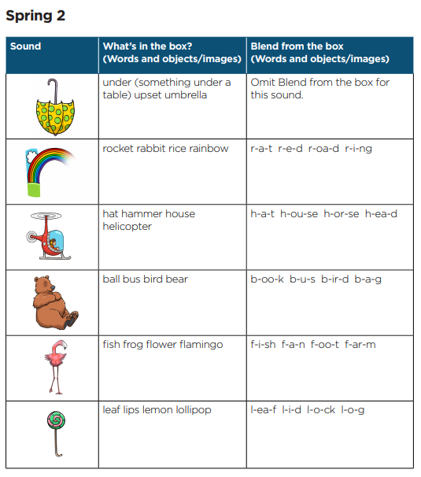
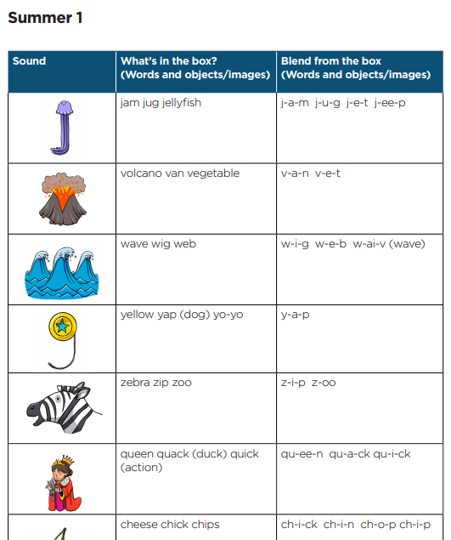
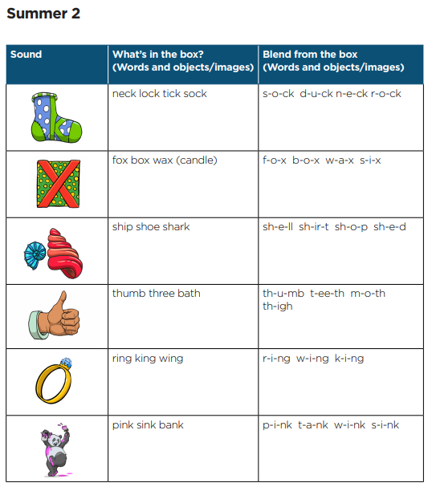
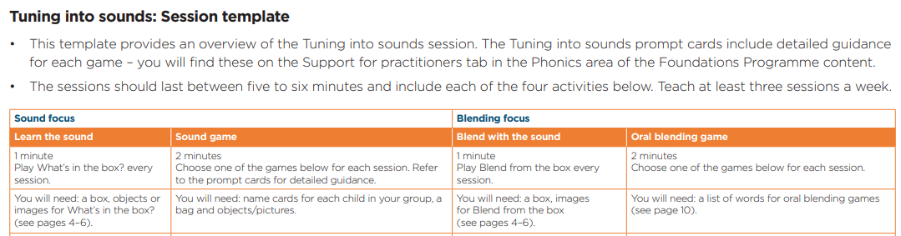
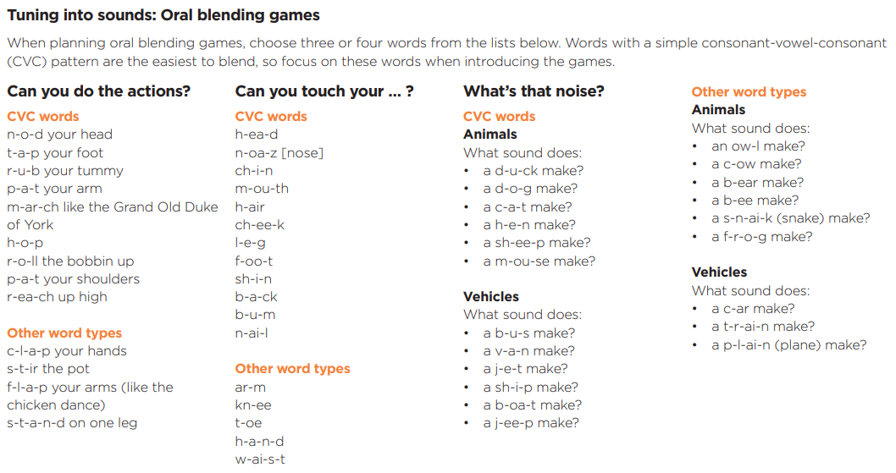
St. Boniface RC Primary
Nursery
Phonics Yearly Knowledge Overview

